Slide 1

https://www.uni-goettingen.de/en/48115.html
UNPLAB-BrMeth_Ch-4[GCAII]
Employ GCA in Synthetics
1

Slide 2
Sequential Number: #22
UNPLAB-BrMeth_Ch-4[GCA II]
Unless I explicitly state otherwise, images and cartoons are created using ChatGPT.
You may use this material free of charge under the terms of the CC BY license. This requires that you provide appropriate attribution to the author: W. Link, University of Goettingen, Germany.
In a few cases, individual images, photographs, or similar material may be subject to a more restrictive Creative Commons license. Where this applies, it is explicitly indicated, and you must comply with the stated license terms for those items.
Please check the license information carefully before reuse. Responsibility for complying with the applicable license terms rests entirely with you.
2

Slide 3
You already know: Population Genetics, Heterosis, GxE, GCA, SCA
Keywords of this chapter:
GCA as common parameter for hybrid and synthetic cultivars.
Inbreeding in synthetic cultivars, Sewall-Wright-Equation.
Necessity to predict, because not all the very many possible candidates of (2Way) 3Way 4Way Synthetics can be produced and field-tested.
Algebra as introduced in this chapter:
This is the famous Sewall-Wright-Equation: Y = C – (C-S)/N
For instance cf. https://cdnsciencepub.com/doi/pdf/10.4141/P97-076
3

Slide 4
“A Topcross ...
that uses an equal-dose mixture of the candidates as tester
is genetically equivalent to a ...
Polycross”
4

Slide 5
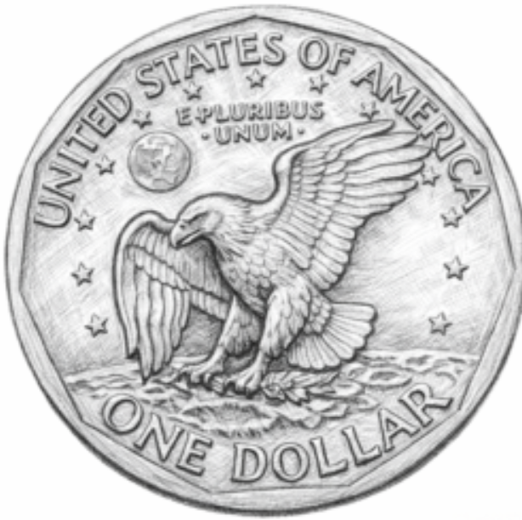
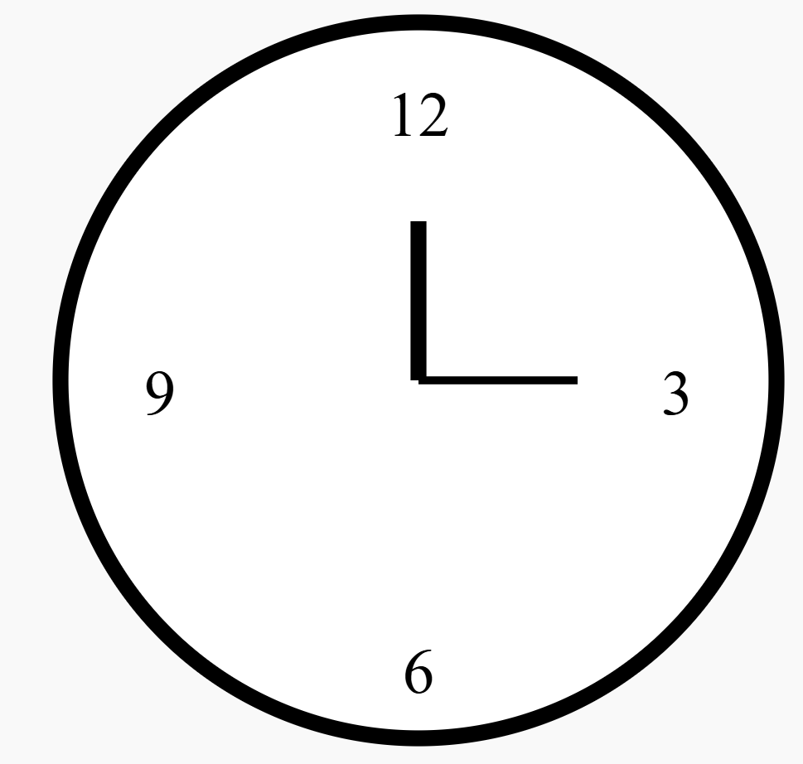
This is now about Hybrid Breeding; yet, the Breeding Categories and Methods are nevertheless presented only later.
Strategic steps in Hybrid Bbreeding (yet, bear in mind that breeders typically do not obey such textbook-like ‚rules‘)
1
Develop inbred lines (via a DH-technique* or via selfing) and test a high number of them for per se performance, especially for traits such as seed quality (seed-to-be-sown), pollen production (‚mother‘ or ‚father‘ features), flowering time. Select accordingly.
2
Conduct with these best lines a Topcross & Topcross-Test, assess their GCA (yield, fur-ther agronomic traits); select again.
3
Produce seed from a Diallel- or Factorial-cross, based on these very best lines, test the corresponding hybrids. Identify (select) the parents of these best hybrids.
4
Employ the parental lines of these best hybrids to again produce (seed for) these best hybrids (by now they are potential cultivars), use this seed to apply for official tests.
5
Have your candidate released as cultivar, convince farmers to grow it, realize return-of-investment and profit via royalties (licences; included in seed price; or any other system).
*see later
Assessment and Selec-tion is increasingly supported by so-called ‚Genomic Prediction*‘.
5

Slide 6
Although seed of Hybrid cultivars is produced by controlled crossing (father pollinates mother; seed growing on father and pollen from mother are excluded or avoided; Bestäubungslenkung; pollination control, pollination management) ...
whereas seed of Population cultivars such as Synthetic populations are produced without such control but by ‘open’ pollination (according to the natural mode of the plants; approximately Random Mating) ...
there are, as to realization of GCA and SCA and of Heterosis
several overlaps and similarities between Hybrid cvs. and Synthetic cvs.
One similarity is that, in Germany, use of farm-saved seed of hybrids and synthetics is illegal §§; which genetically makes sense in hybrids and not in synthetics.
6

Slide 7
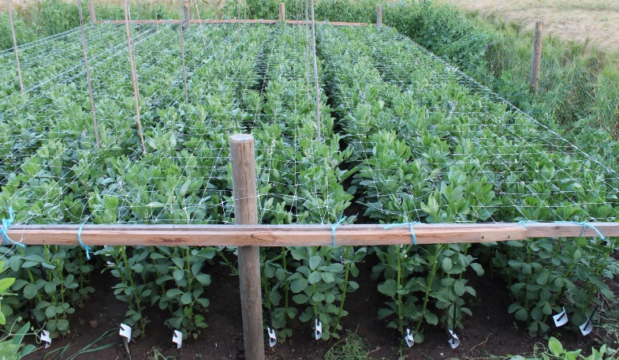
Towards a N=5 components-based population (‘Synthetic’; UNPLAB-BrMeth_Ch12[TheFour IV], page 10ff.)
Ideally, Random Mating between e.g. 5 inbred lines leads to offspring (offspring population) which is 20/25 = 80% composed from all pair-wise crosses between them and 5/25 = 20% composed from crosses within them (i.e. selfing; Random Mating means: “Selfing included”). The Reference Population has N_{e}=∞ genotypes and hence, selfing is absent there, since 1/∞ = 0. Here, probability of selfing is 1/N=1/5. Mind: Crossing between individuals of the same homozygous line is genetically selfing. By the way: 20/25 = (N²-N)/N² = (N-1)/N; 5/25 = N/N² = 1/N.
Five of our 10 parental lines
© Brünjes
µ=50.36
You know anyway: Data is yield. Blue is per se of inbred lines ‚themselves‘, black is yield of all F1s between the lines. Reciprocals yield same by copy-paste ;-) and GCA is taken from our 10x10 Diallel.
7

Slide 8
8
N=5 components ‘Synthetic’ and GCA-relevant features of such population
Ideally, random mating between e.g. 5 inbred lines leads to offspring (offspring populations) which is 20/25 = 80% composed from all pair-wise crosses between them and 5/25 = 20% composed from crosses within them (means selfing). Random mating means: “Selfing included”. The reference population has N=∞ genotypes and hence, selfing is absent there, since 1/∞ = 0. Here, probability of selfing is 1/N=1/5. Mind: Crossing between individuals of the same homozygous line is genetically self-fertilization. By the way: 20/25 = (N²-N)/N² = (N-1)/N; 5/25 = N/N² = 1/N.
What if we took these 20 F1-hybrids + 5 lines and propagated this first-offspring again via Random Mating) ... then 25 genotypes mate and create 25² = 625 offspring types. These are 25 selfings (selfings of pure lines & of F1s); 600 matings are non-selfing-matings (back-crosses & other types of matings).
µ=50.36
What would be the result? Population Genetics tells the easy answer (UNPLAB-PopGen_Ch-2[HWE II]; page 4).
If there was no Selection/Mutation/Migration/Drift, then the first offspring from Random Mating (this page) was already in HWE and each further Random Mating (next page) would not change the genotype frequencies.
For instance … if the five initial lines had private alleles at a locus, such as … A₁, A₂, A₃, A₄, A₅. Then the frequen-cies of these alleles is p=q=r=s=t=20%. The frequency of heterozygotes in HWE is: ∑(H)=2pq+2pr+2ps+2pt+2qr+2qs+2qt+2rs+2rt+2st. In short: ∑(H) = 10 ∙2∙0.2∙0.2 = 80% ... yes, you knew this ;-).
Message: These frequencies (80% heterozygotes plus 20% homozygotes) would not change after a second (and third …) ideal random mating. Shall we check this?

Slide 9
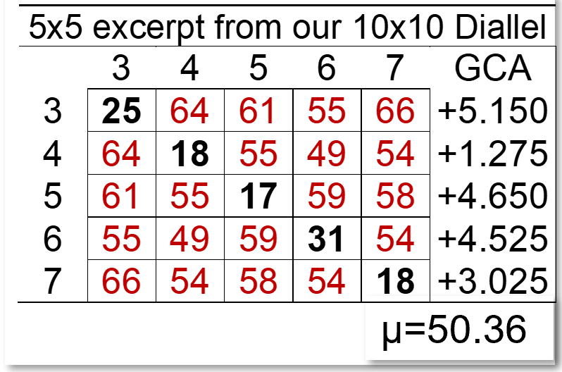

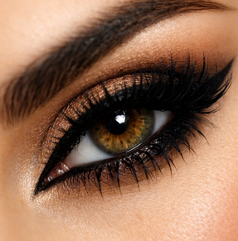
Shall we check this? N=5 components-based population (https://s.gwdg.de/T4zUtT).
25 x 25
Diallel
What if we took 5 lines & their 20 F1s and random-mated them (again)? What would result? Nothing would happen!
Well. The expected performance would stay the same because the genotype composition would stay the same.
The average inbreeding coefficient, µ_{F}, would, by the way, stay the same, too.
The first random mating (‘5x5’) leads to
µ_{F} = 0.8 ∙ 0.00 + 0.2 ∙ 1.00 = 0.20
The second random mating (‘25x25’) leads to (check the patchwork-table):
µ_{F}=(260∙0 + 240∙0.25 + 120∙0.5+5∙1)/625 = 0.20
What a waste of patience and time to create this patchwork-table just to see ‚No Change‘ ☺
240∙0.25
µ=50.36
9

Slide 10

10
“HWE is reached in one generation of random mating”. Nevertheless …
Limitations, Constraints.
This consideration is valid as long as the single-locus perspective is good-enough. Mind: After one generation of Random Mating, the population is in HWE for each single locus. Means: This is without looking on joint-occurrences of loci and genotypes. Here, after the first generation of Random Mating, in 1/5 of the offspring we do have still the initial homozygous lines and they are not only homozygous at one but at all loci simultaneously – oh oh oh ...
this is not convincingly ‚random‘ ;-) This may have impacts.
Epistasis (Genetic)
Competition (crop stand and canopy features)
µ=50.36
After further generations of random mating, a multi-loci HWE is reached (stepwise; see UNPLAB-PopGen_Ch-10[LD II; page ~4]). In genetic terms: Gamete Phase Disequilibria is decaying. If we have Epistasis, then further Random Mating may change trait expression (polygenic traits). Moreover, with multi-loci HWE, heterotic differences between genotypes are smaller: The ‘pure’ initial (homozygous) types do barely or not exist any more; all plants are inbred more or less to a similar extent. Their cooperation-competition-complementation-compensation-facilitation ... https://s.gwdg.de/VoATRn ... in the crop stand (canopy) may well be different from the first-offspring generation. So: Further (Random Mating) multiplications may for such reasons modify the crop-stand and its yield performance!

Slide 11
With this detailed insight, we go now back to the GCA and SCA-based composition of Hybrids and of Synthetic populations.
We know that:
Seed for a Mendelian hybrid as cultivar has to be re-produced via the controlled cross mother x father each ‚time‘;
whereas:
Seed for a synthetic population cultivars can, essentially, be produced by ‚just‘ harvesting seed for a further generation from and for the (randomly mating) cultivar.
This ‚advantage‘ is paid by a ‚disadvantage‘: The plants of such synthetic cultivars are, even in case of perfect Random Mating, to some extent inbred.
With N inbred lines as components, the average inbreeding coefficient µ_{F} = 1/N.
With N non-inbred genotypes as c., the average inbreeding coefficient µ_{F} = 1/2N.
*
* This is true for diploids, not for autopolyploids, as you know!
11

Slide 12
Not one best bi-parental ‘single-cross’ hybrid but a N=5 components-based population.
We chose those five lines that showed the largest, positive GCA effects.
1
The average of these N=5 inbred lines is:
µ_{(L)} = 21.8
The average of their 2 x 10 F1-hybrids is:
µ_{(F1)} = 57.5
µ=50.36
The mean of the
10 x10 Diallel ...
12

Slide 13
Not one best bi-parental ‘single-cross’ hybrid but a N=5 components-based population.
The five lines with the largest, positive GCA effects - and their 2 x 10 F1-hybrids.
With
(0.2∙21.8) + 0.8∙57.5) =
50.36
Wee see how this result can be decomposed.
This population‘s perfor-mance is mainly resul-ting from its hybrid com-ponents‘ yield, their share is (N-1)/N; and to a lesser extent by the in-bred lines‘ yield, their share is 1/N.
Mind:
These are selected lines and their F1-hybrids.
The average of these N=5 inbred lines is:
µ_{(L)} = 21.8
The average of the 2 x 10 F1-hybrids is:
µ_{(F1)} = 57.5
µ=50.36
Mean of 10x10 Diallel
13

Slide 14
The next pages introduces and explains the Sewall-Wright equation.
So, although often stated differently,
there is not just one „the“ Breeder’s Equation.
The Sewall-Wright equation is important for Breeding, especially for Heterosis-Inbreeding-related development of cultivars.
I am often writing important terms such as Random Mating ... with First Letter Capital – that's just my quirk, it has nothing to do with official spelling rules.
By the way, I try to write British English.
14

Slide 15

Not one bi-parental ‘single-cross’ hybrid but a N=5 components-based population.
0.2∙21.8+0.8∙57.5=50.36
$\frac{1}{5}$ ∙ 21.8 + $\frac{4}{5}\text{∙} \text{57.5}\text{=}$50.36
(N-1)/N=0.8; 1/N=0.2
In a different shape, we may write
50.36=57.5-(57.5-21.8)/5
This is then the famous
S.Wright-Equation
Y = C – (C-S)/N
C = µ_{(F1)} = 57.5
S = µ_{(L)} = 21.8
The average of these N=5 inbred lines is:
µ_{(L)} = 21.8
The average of the 2 x 10 F1-hybrids is:
µ_{(F1)} = 57.5
µ=50.36
Sewall Wright says: This N-component-derived synthetic population is expected to yield according to the mean of its non-inbred F1-components (µ_{(F1)}; he writes „C“). Yet, since the inbred lines are contributing as well, their inferiority „C-S“ has accordingly to be acknowledged. The expected yield Y is then: C minus 1/N ∙ (C-S).
ISBN-10:‎ 0265895146.
15

Slide 16
Not one bi-parental ‘single-cross’ hybrid but a N=5 components-based population.
µ_{F1} = 50.089
Mean of these five GCA-effect is 3.725;
Mean of the 5 inbred lines 21.8;
Prediction is
0.8 ∙ (50.089 + 2∙3.725) +0.2 ∙ (21.8) = 50.3912
Let us, just for fun, predict this synthetic popu-lation based on GCA and the lines‘ per se performance.
µ=50.36
The small difference between this prediction Y=50.3912 and the former prediction Y= 50.36 is caused by what?
It is caused by the fact that just now, we only included GCA, whereas before, we included all ten F1s‘results. Thus, implicitly, we included both: GCA and SCA effects. The mean of the ten SCA-effects is, as expected, small.
16

Slide 17
Not one bi-parental ‘single-cross’ hybrid but a N=5 components-based population.
17
µ_{F1} = 50.089
Mean of these five GCA-effect is 3.725.
Mean of the 5 inbred lines 21.8.
Prediction is
0.8 ∙ (50.089 + 2∙3.725) +0.2 ∙ (21.8) = 50.3912
Let us, just for fun, predict this synthetic popu-lation based on GCA and the lines‘ per se performance.
µ=50.36
Bene considera: This thus-predicted yield of this N=5 component synthetic population will be a prediction for the generation Syn-1 - and for later generations, provided (from Syn 0 onwards) truly Random Mating* / no Selection / no Mutation / no Migration / no Drift, no Epistasis, no marked effects of (different) competition behaviour of genotypes across these generations. *e.g.: No self-incompatibility. This are really many assumptions.

Slide 18

18
Now we – again – consider the prediction aspect of Plant Breeding.
Specifically the prediction of the performance of hybrid and synthetic cultivars.
Prediction of their yield, based on features of their parents aka components.
So to say to select between conceptualized hybrids and synthetics without really producing seed-of-them and field-testing them.
It is to some extent like ‚flying by blind‘ instead of ‚flying on sight‘

Slide 19
It is to some extent like ‚flying by blind‘ instead of ‚flying on sight‘.
Breeding Hybrid cultivars
We assess per se performance and predict GCA based on correlation;
We asses GCA and predict F1-hybrid performance based on correlation …
… and produce seed, field-test and see only the very-best predicted F1 candidates.
Breeding synthetic cultivars
We assess GCA and predict all possible synthetic cultivars that can be made from the tested components …
… and produce seed, field-test and see only the very-best predicted synthetic candidates.
Do we need the per se performances of the components for prediction of synthetics? Mind, synthetics are to some extent inbred, their performance is not displayed on zero-inbred niveau.
19

Slide 20
It is impossible to field-test all combinations.
E.g.: How many N=8-components synthetics could one make from K=10 components?
K components available, N components used per population. Number of possible different combinations is
(K!) / [(K-N)!)∙N!]. With K=10 and N=8, we have 45 possible combinations.
The number of ‘N=2’-based synthetics if we have K=10 is – by the way – again 45; you see the point ;-)
20
1
2
3
4
5
6
7
8
9
10
1;2 1;3 1;4 1;5 1;6 1;7 1;8 1;9 1;10 2;3 2;4 2;5 2;6 2;7 2;8 2;9 2;10 3;4 3;5 3;6 3;7 3;8 3;9 3;10 … 9;10
1 2 3 4 5 6 7 8 9 10 11 12 13 14 15 16 17 18 19 20 21 22 23 24 … 45

Slide 21
It is impossible to field-test all combinations.
We must have a high number K of candi-dates to select from, otherwise we cannot conduct hard selection and hence cannot make large gain from selection. The best candidate out of e.g. K=5 is expected with only 1.16 standard deviations superiority over the mean …
… given that data follows the Normal Distribution; whereas the best candidate out of e.g. K=20 is expected at ~1.87 standard deviations. The best of K=50 is at 2.249. The best of K=1000 parents is at 3.367. You see that with more meaningful numbers of K it is impossible to test all possible combinations, even if the task is ‚only‘ to test single cross hybrids (N=2). A very hard reduction of numbers, a very hard pre-selection is absolutely necessary. Such pre-selec-tion is conducted based on (per se and) on GCA data. More general, based on a fast-cheap approach – even if that is not giving exact results (UNPLAB-BrMeth_Ch-11[TheFour GS]). Mind (read thrice): The requirement is not ...
„Do not lose in the pre-selection any of those who may later-on prove to be among the best ones“ ... but
„Do not allow a looser to pass the first threshold and to consume more of your budget“!
21

Slide 22
It is impossible to field-test all combinations.
1800
With K=10 and N=8, the question is: How many different sets of 8 can we have if we choose from K=10? This is, how many different pairs of 2 can we leave out from the 10? K=10 means 10²=100 pairs-of-two. Ignore the diagonal and choose only one of the two reciprocal directions. Thus (100-10)/2=45; thus, we can make 45 different sets of 8. And so on.
With K=4, we can make only one N=4 synthetic yet 3 different 3-way crosses. These different 3-ways are:
(1x2)x(3x4)
(1x3)x(2x4)
(1x4)x(2x3)
You will easily see that the difference lies in ‘which SCA-effects are or are not transferred to farmers‘ fields’.
Single-cross
1600
Threeway-cross
Fourway-cross
1400
Synthetiks, N=4
Synthetiks, N=8
1200
1000
Number of possible cultivars (combinations)
800
600
400
200
0
0
2
4
6
8
10
12
14
16
18
20
Number K of parental components available
22

Slide 23
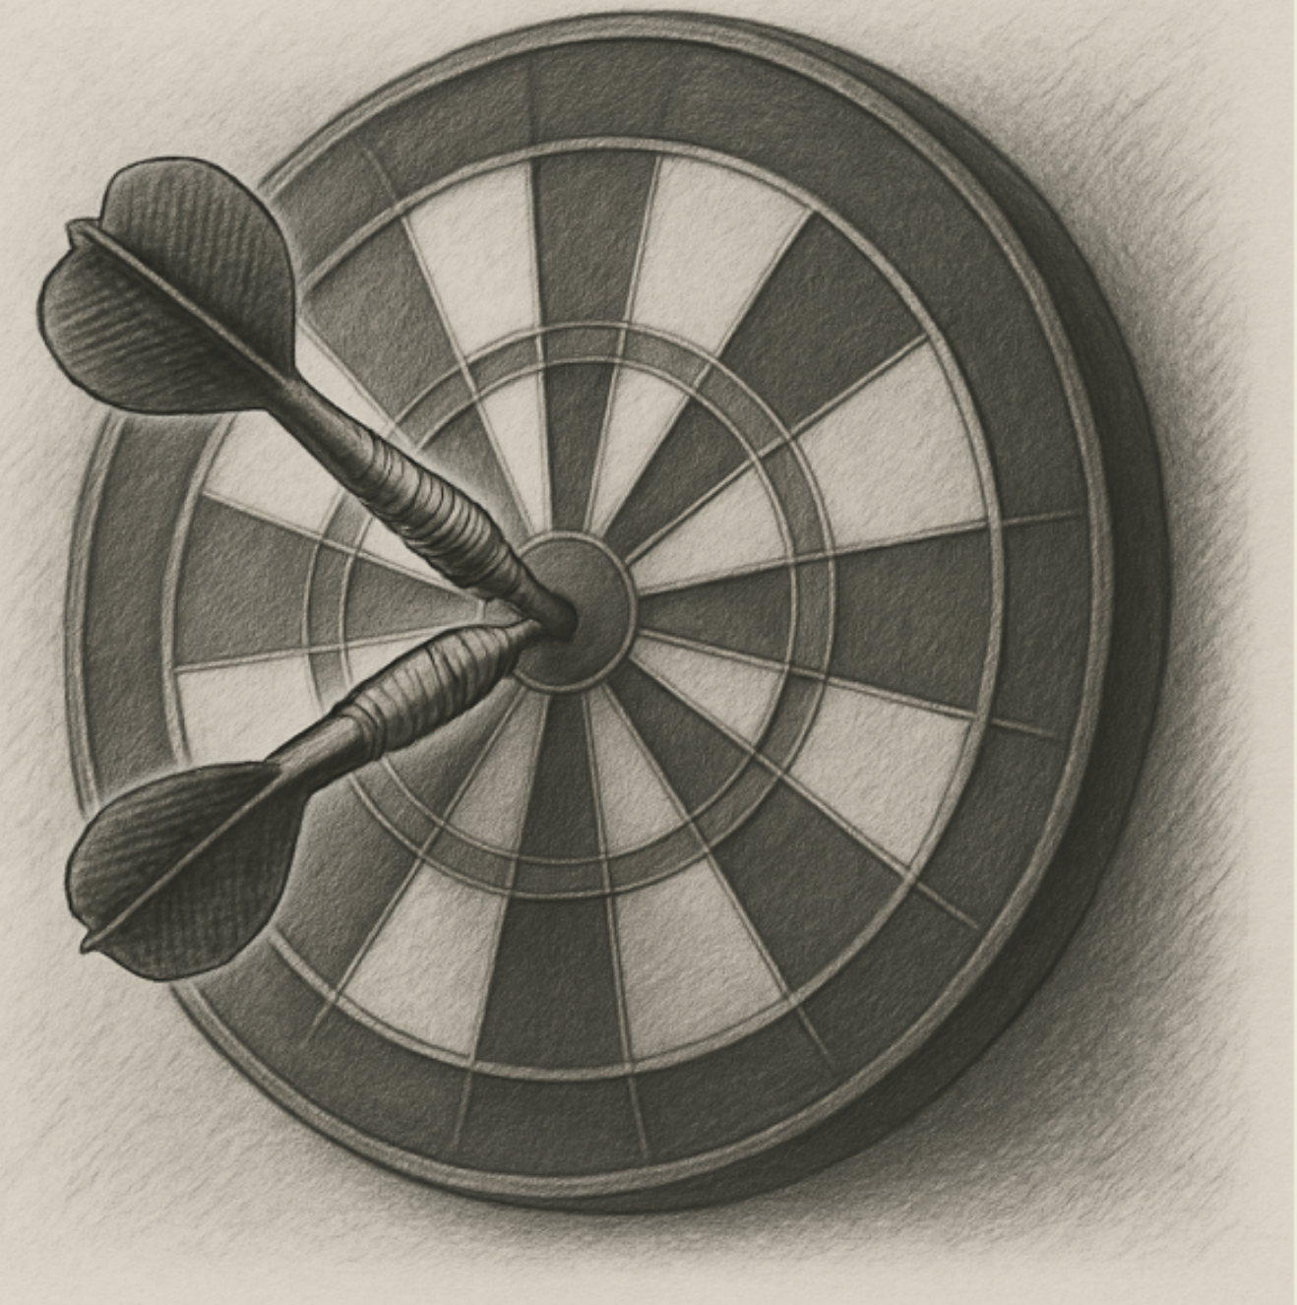
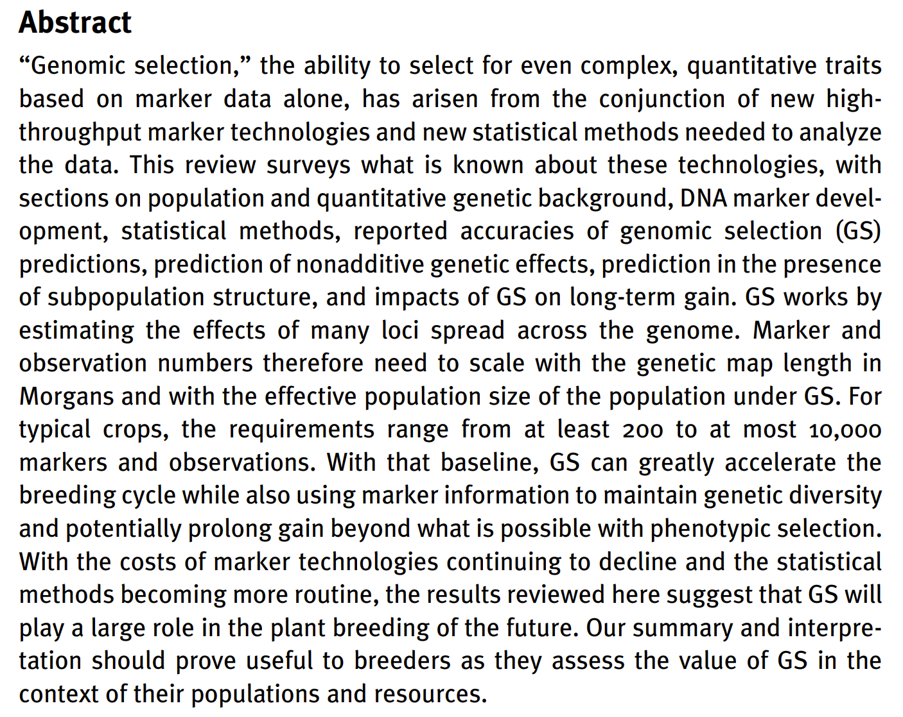
Genomic Selection, Genomic Prediction.
Since several years* we see the transition from the classical, purely phenotype-based
Selection to Selection based on either Phenotype or Genotype or Combined Phenotype & Genotype (& Pedigree).
See UNPLAB-BrMeth_Ch-11[TheFour GS].
*written in 2026
DOI 10.1016/B978-0-12-385531-2.00002-5
Lorenz, ... Jannink, 2011. Advances in Agro-nomy 110, 77-123.
23

Slide 24
From here you may go to UNPLAB-BrMeth_Ch-5[RecSel I]
24

